Slide 1
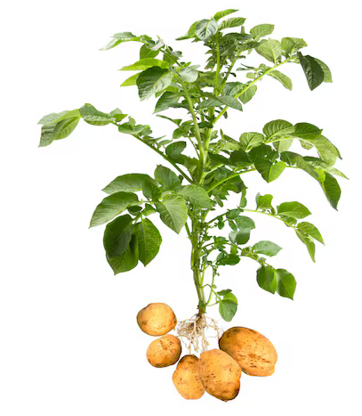
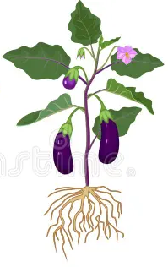
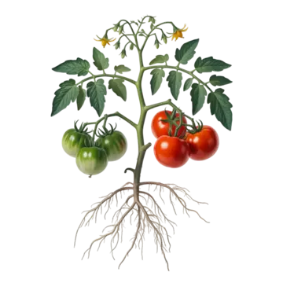

Slide 2
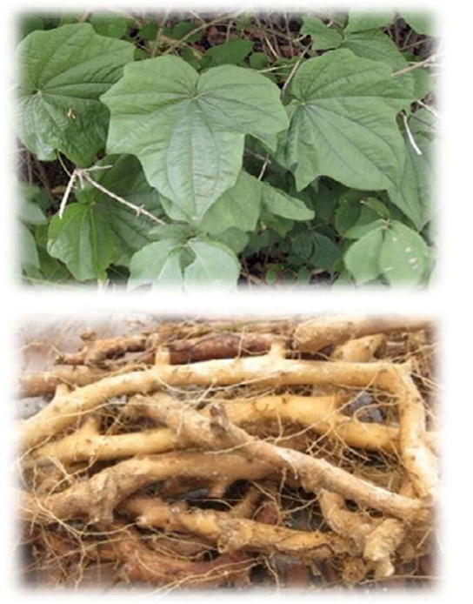
American Potato
Japanese Yam
Phylogenetically unrelated
Both need protection against fungi in earth!

Slide 3
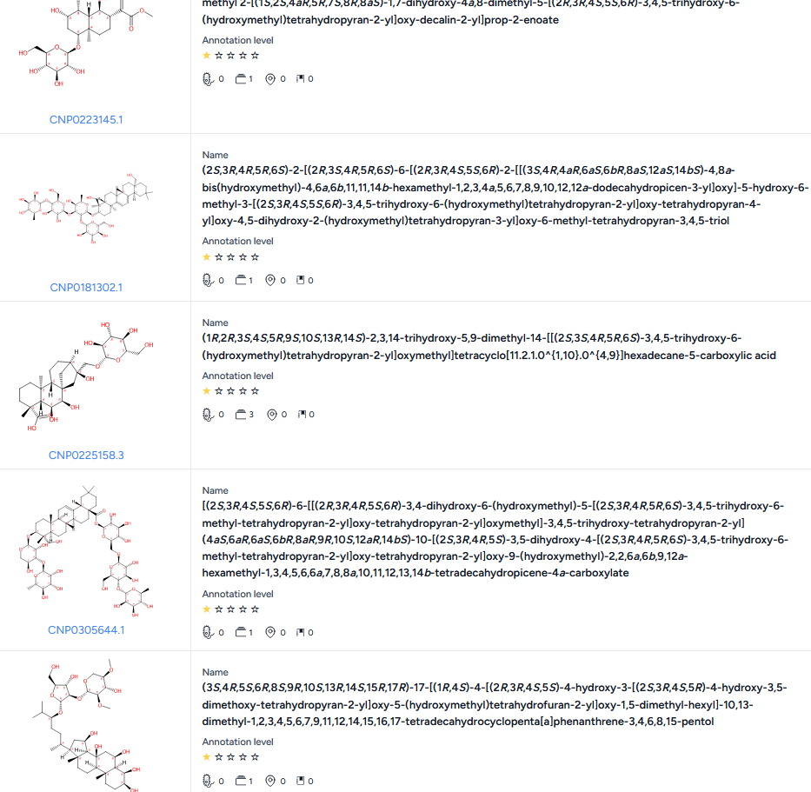

„Glycosylated“
„Terpenoid“

Slide 4
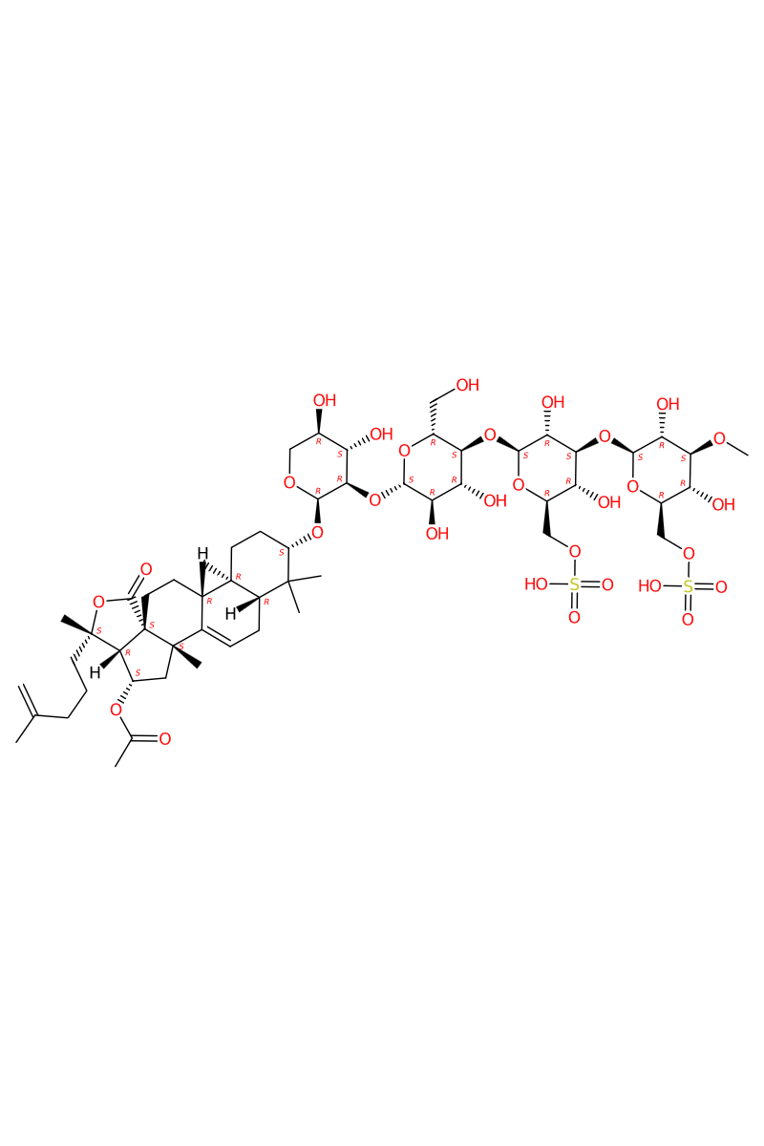
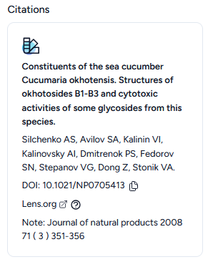
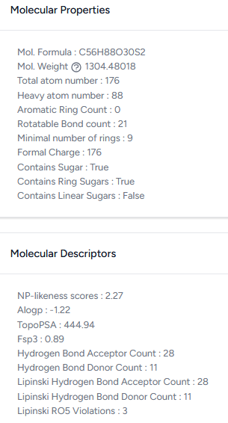
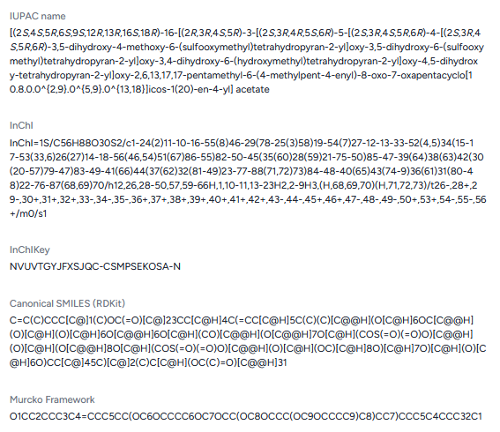
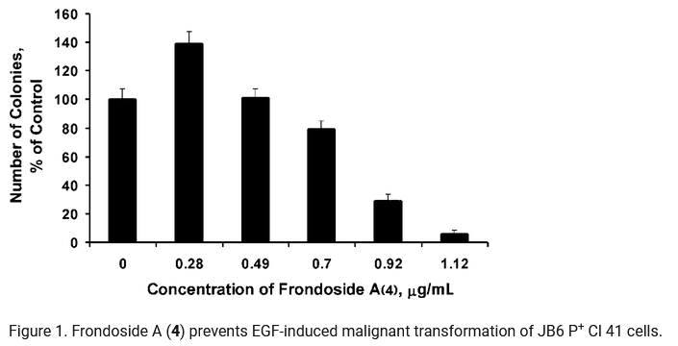
Okhotoside B3
Cucumaria okhotensis

Slide 5
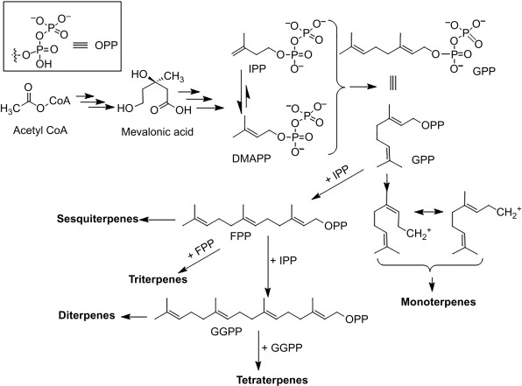
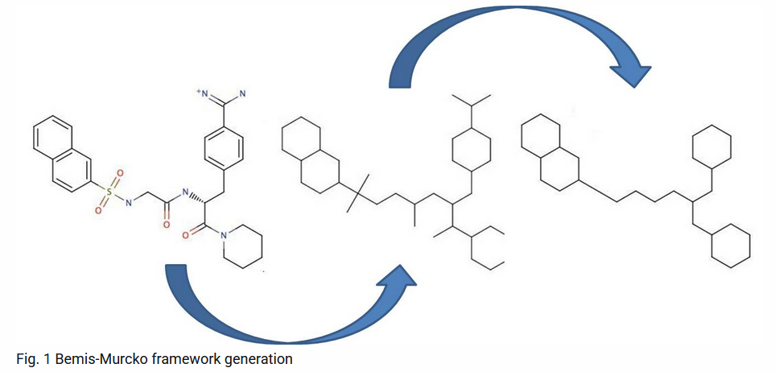
Murcko Scaffold as base
Everything else is „decoration“ and used for a likeness score for secondary clustering
Sulfates, acylation, alkylations, etc. are „decoration“ and used for secondary clustering

Slide 6
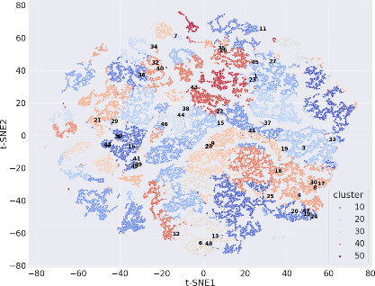
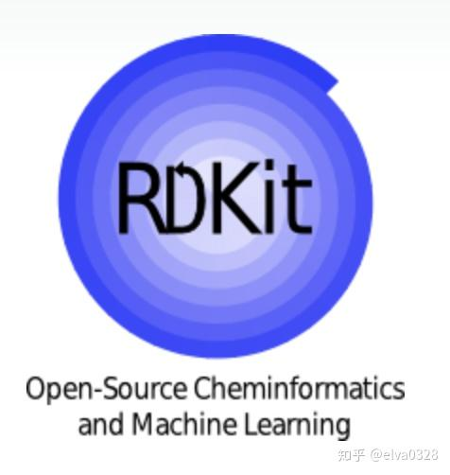

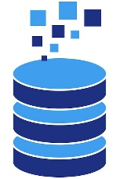
Opensource DATABASE
Databases
Data Mining
Clustering
Endgame
Splitter
Glycan
Chop from both sides and generate substructures down to mono-saccharides
(keep data about modification and position)
Aglycon
Bemis-Murcko scaffold
(keep data about stereochemistry, heteroatoms and modification for similarity score)
Glycan
2. Aglycon
3. Modification Glycan
(similarity score)
4. Modification Aglycon
(similarity score)
1 - Understand patters
(glycosylation and aglycon)
2 - Connect structure
and activity
3 – A structured pool of high-evidence data allows to investigate glycans and plan artificial conjugates
Moon shot:
Make artificial saponins with predictable bioactivity
Failsafe:
Best review out there
Algorithm
for structure
and meta data
(organism, parent compound, subclass, (c)logP, H-bond donor/acceptors, etc)
LLM
to extract bioactivity and short summary from publications
COCONUT
KNApSAcK
Scifinder
ChEMBL
GlyCosmos
PubChem

